Slide 1
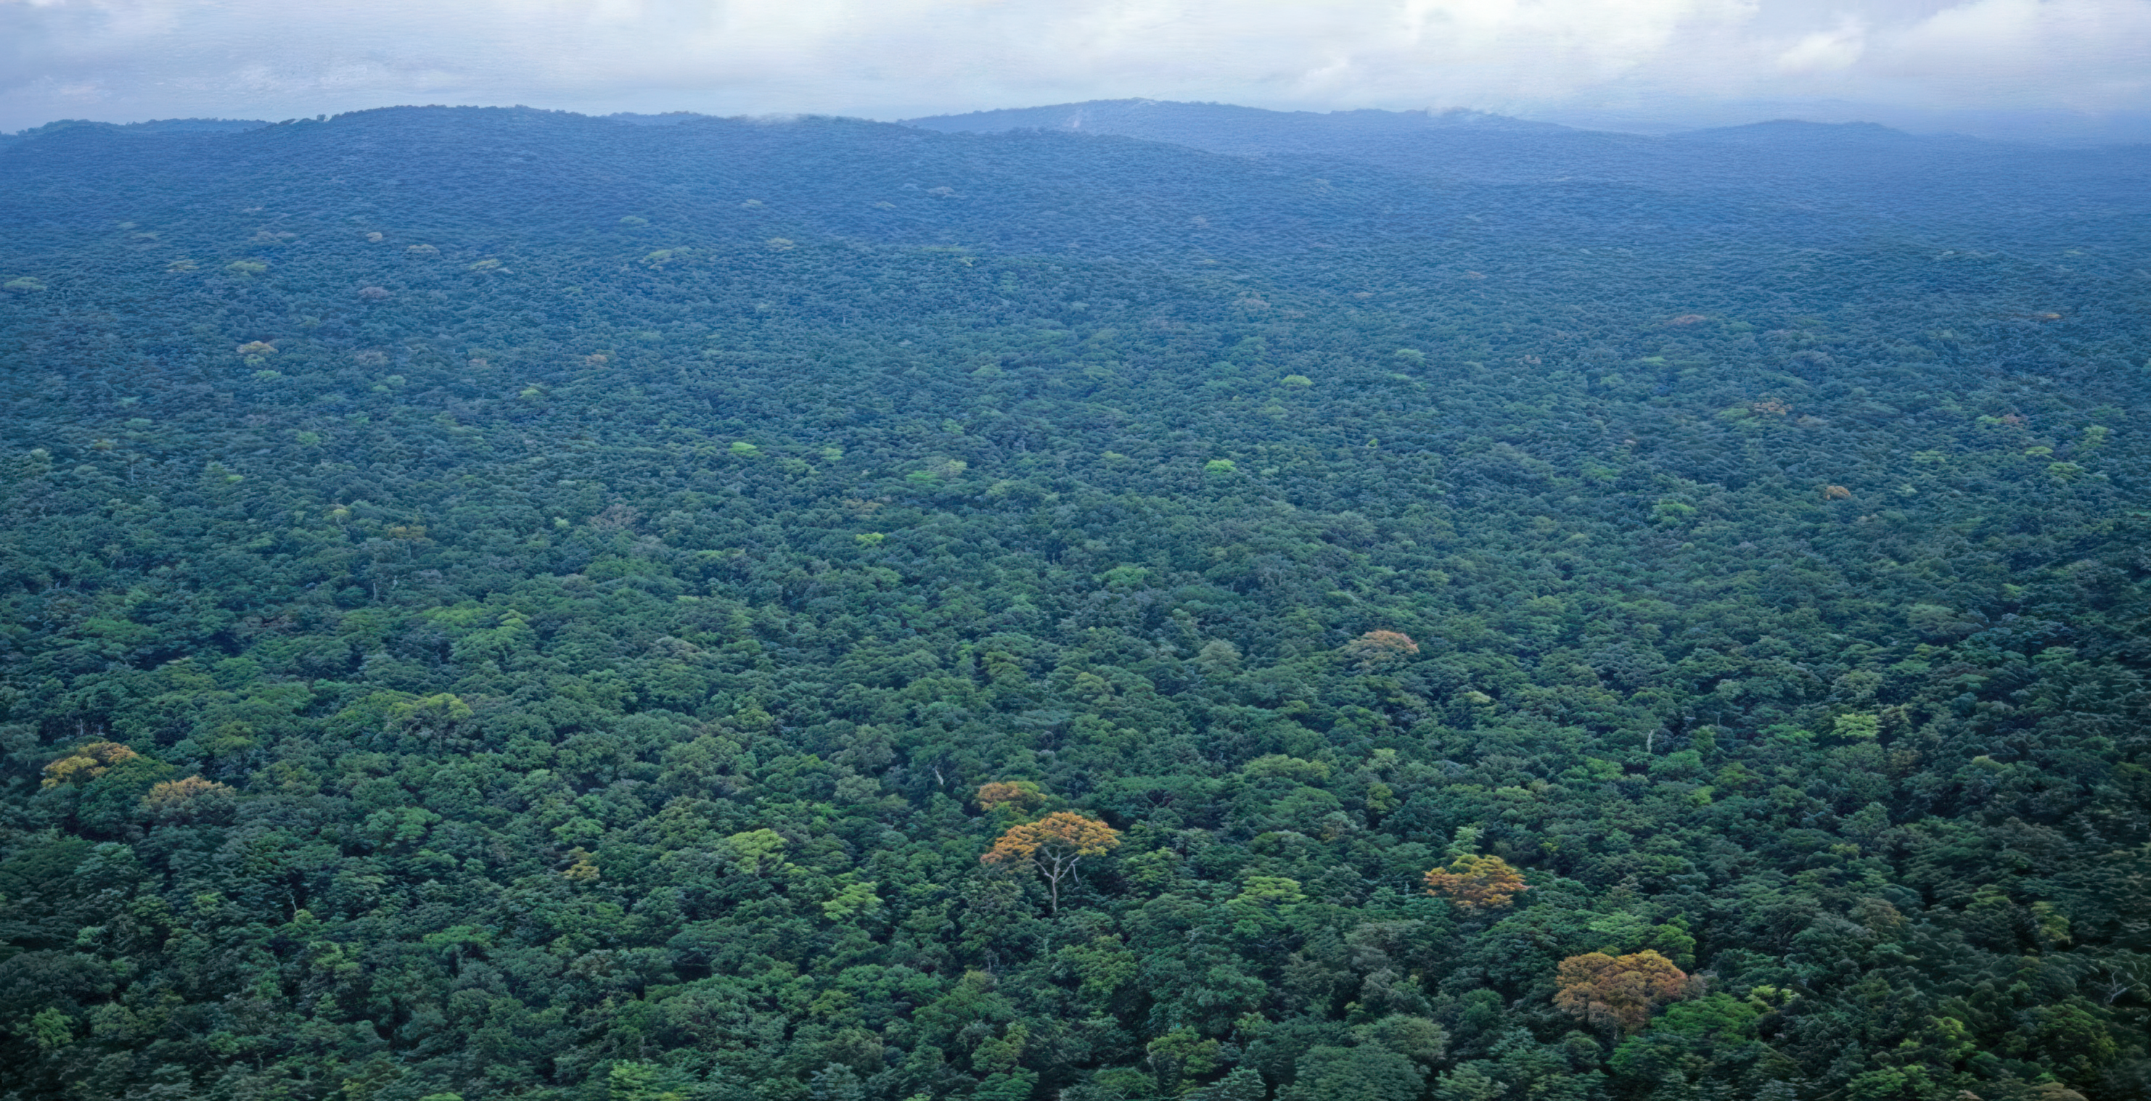

COMMUNITY AND CONSERVATION FOREST IN THE GOLA RAINFOREST
Meeting in Liberia, November 3rd, 2025
Presented by:
Fomba A. Kanneh
MOE/Gola

Slide 2
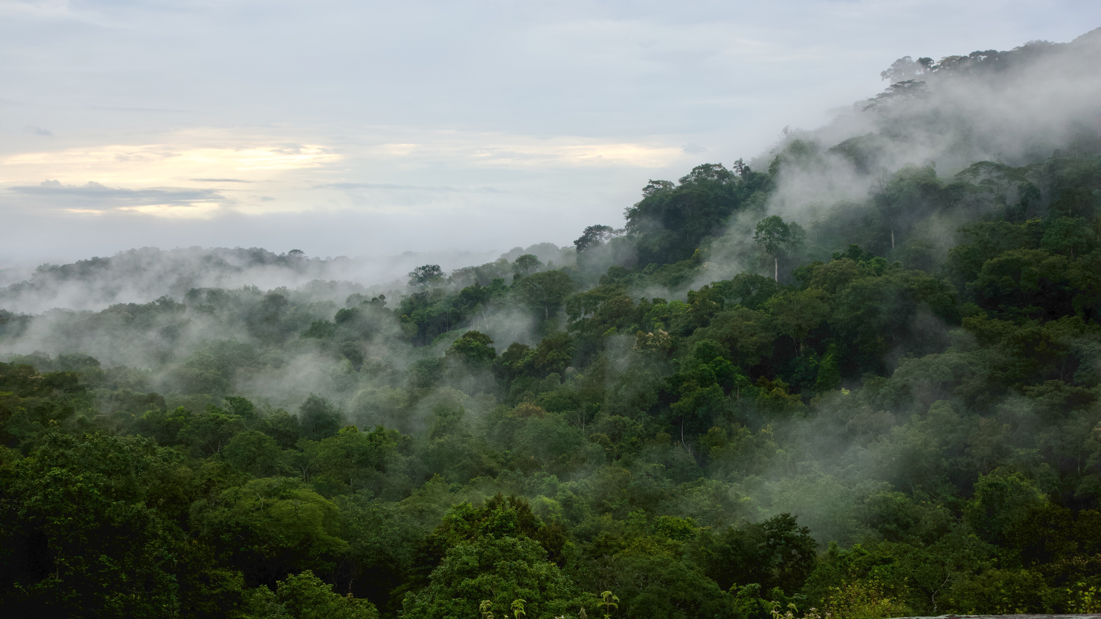

The Gola Rainforest National Park Securing a Future for Forests, People, and Biodiversity

Slide 3
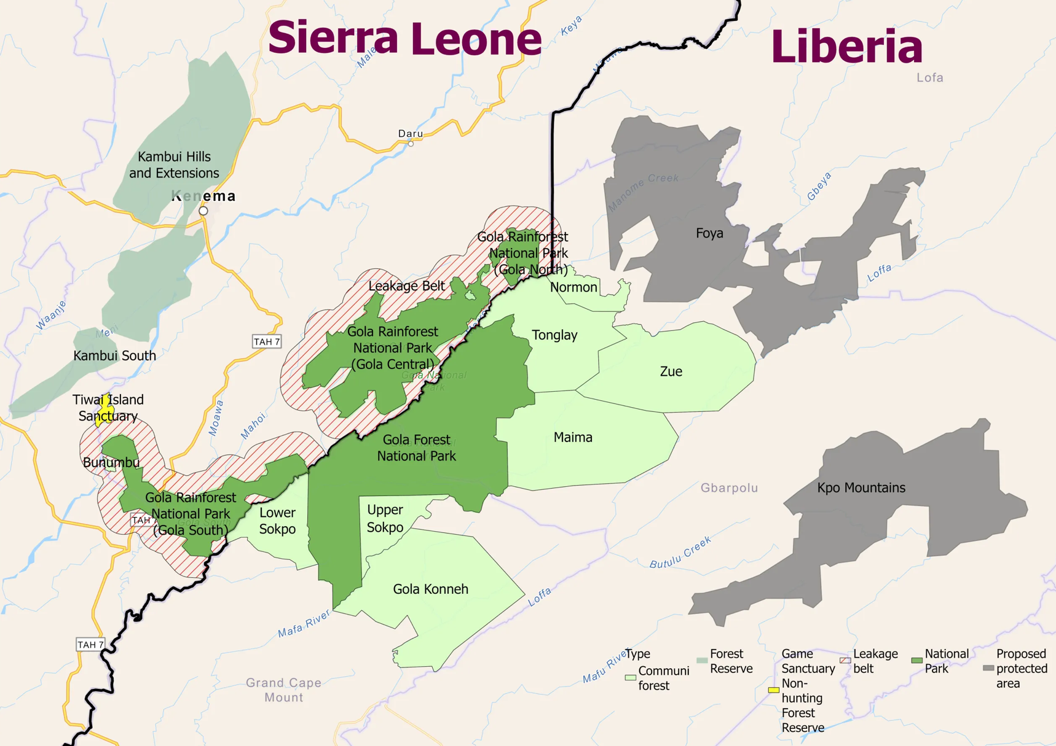
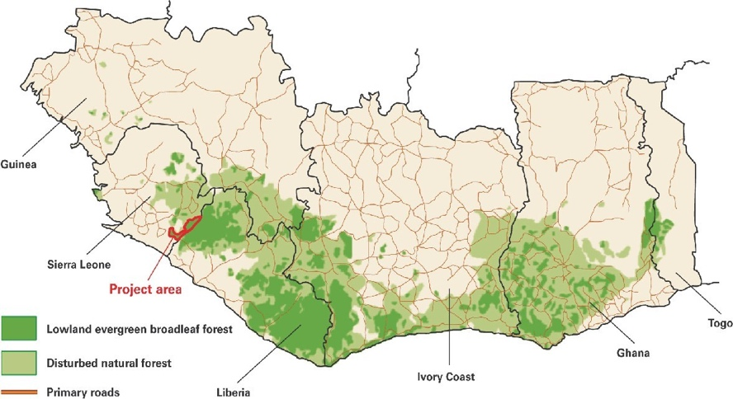
The Greater Gola Landscape A Transboundary Landscape Sierra Leone and Liberia

Slide 4
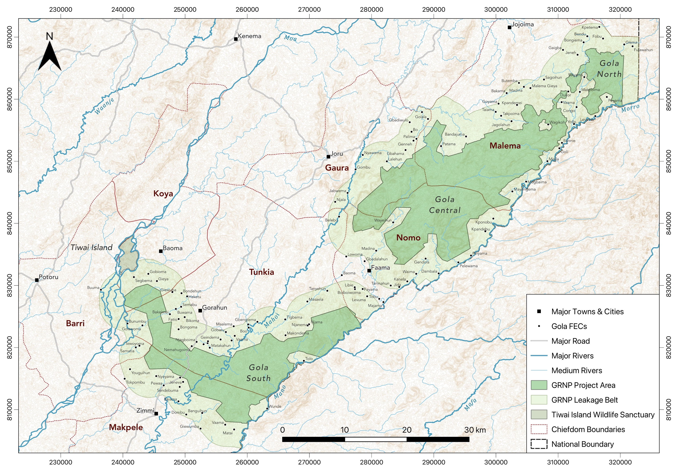
Gola Rainforest National Park
Established in 2011
70,000 ha of protected forest
4km ”Leakage Belt”
7 Gola Chiefdoms
122 Forest Edge Communities
480+ Offsite Communities

Slide 5
Gola REDD+ Project
Date | Milestones
2002 | Gola Conservation Concession Framework officially established to develop a multi-stakeholder approach to the conservation and management of the Gola Forest Reserves.
2006 | Scoping study carried out to investigate long term financing strategies for protected areas in Sierra Leone concludes that REDD financing has potential
2007 | Cooperation and Benefit Sharing Agreement between the local communities and partners (National Commission on the Environment and Forestry – NaCEF, RSPB, CSSL and the seven Chiefdoms) signed
2008 | First REDD feasibility study carried out for Gola forests by Eco-securities concludes that REDD could create sustainable funding for the management of Gola Rainforest.
2009 | First comprehensive management plan finalised (2007-2012)
2010 | Gola Rainforest National Park declared on 25 November 2010
2011 | Second REDD feasibility study and preparations begin to develop a REDD project
2012 | 1st August, Gola REDD+ Project start date
2012-2013 | Agreements signed between landowner representatives and the Government to exchange carbon rights for project benefits. National Park boundaries are demarcated on the ground in agreement in the 86 Forest Edge Communities sharing a direct border. Numerous meetings and dialogue held with Forest Edge Communities and other stakeholders to develop the Gola REDD project activities with the FPIC.
2015 | Gola Rainforest Conservation LG established to act as project proponent for the Gola REDD project. REDD Benefit Sharing Agreement signed by GRC LG and the 7 Chiefdoms.
Scoping
Feasibility
Project Initiation

Slide 6



Dir. Forestry Division
Kate Garnett
Exec. Dir. RSPB
Katie-Jo Luxton
Head Gola Programme RSPB Richard Dixon
Members
Directors
Management
President CSSL
Charles Showers
Exec. Dir CSSL
Sheku Kamara
Elected PC Representative Patrick Kabba Kanneh
Gola Rainforest Conservation
Est. 2015
Head of Gola
Fomba Kanneh
Park Operations
Community Development
Conservation Enterprise
Research & Monitoring
Finance REDD
Administration
Departments
Human Resources
MoECC
Jiwoh Abdulai
Finance Grants
Country Manager RSPB Alade Adeleke
Organisational Structure
The Greater Gola Landscape - Future for Forests, People, and Biodiversity
6

Slide 7
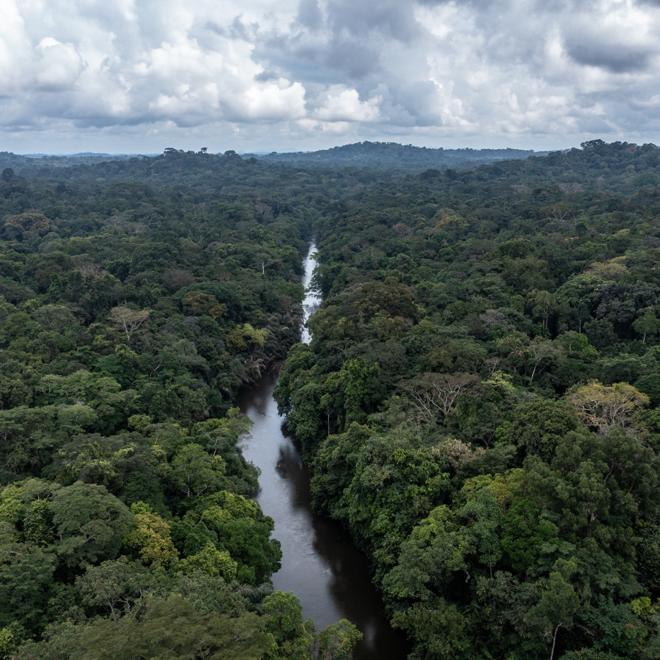


Gola REDD+ Project
Project started in 2012 with 30-year lifespan
Gola REDD+ project follows the voluntary REDD standards offered by Verra
Standards used:
Verified Carbon Standard (VCS)
Climate, Community and Biodiversity Standard (CCB)
Third party assesses the project and its GHG emission reductions and removals against all applicable VCS and CCB Standards rules and requirements.

Slide 8
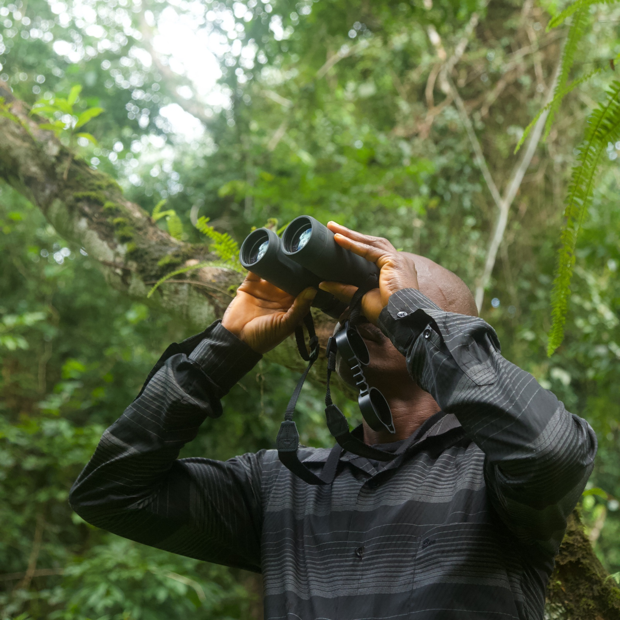
Gola REDD+ Progress
Robust partnership: Government and civil society working together for past 20 years
Protection of the 70,000 ha of National Park and surrounding Leakage Belt of the Gola forest and its biodiversity.
Deliver community engagement and benefits to help protect the forest in 122 forest edge communities.
Job creation and capacity building for about 170 staff to manage the project.
Sustainable financing: carbon credits and trust funds seen as critical tools to deliver this.
Successfully verified by third party assessors twice and currently on the 3rd Carbon verification process
Estimated emissions reductions of about 3.4million tons in the past 10 years

Slide 9
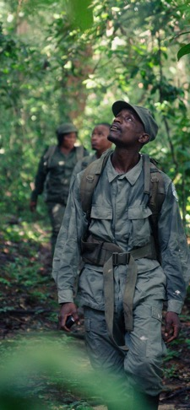
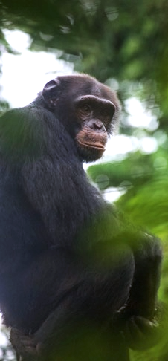
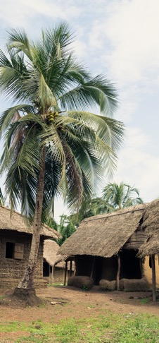
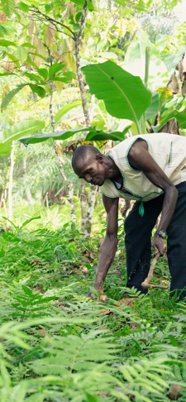
Key Intervention Areas
Protection & Management
Research & Monitoring
Community Outreach & Development
Sustainable Livelihoods & Enterprise

Slide 10
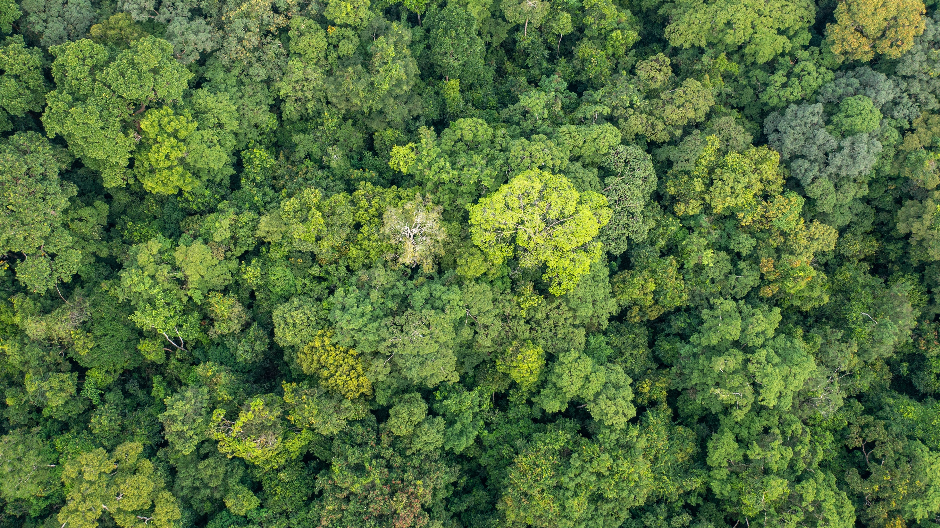
Climate
The project ensures around 19 million tonnes of carbon remain locked within Gola’s forests and safeguarded through sustainable management.
50+ forest rangers trained in surveillance and law enforcement protect the park from illegal human activities.
Emissions reductions of approximately 500,000 tonnes of CO₂e annually.

Slide 11
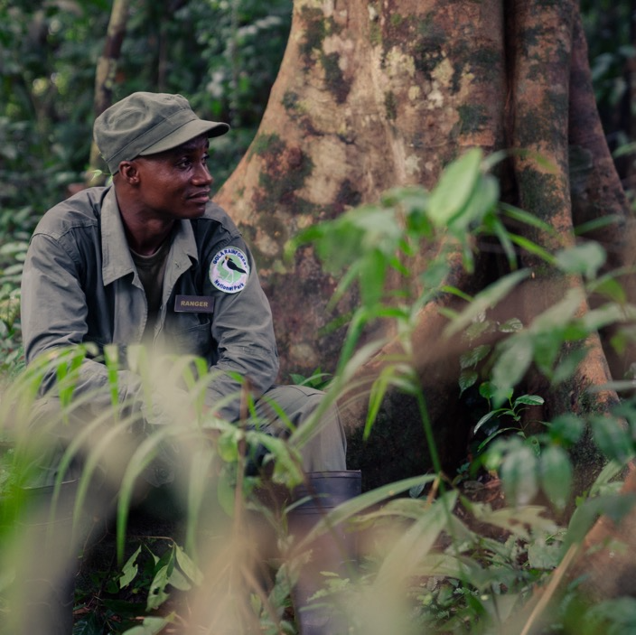




Protection & Management
Law Enforcement Monthly ranger patrols to mitigate threats to the park.
Surveillance
Monitoring signs of illegal activities and biodiversity using SMART.
98%
Patrol Coverage of GRNP from 2024 – 2025
Protected Area Integrity
Boundary demarcation and dispute resolution.
Restoration of degraded sites.
Joint Security
Regular patrols with support from RSLAF & SLP.
Notes:
Discuss key threats: mining, hunting, logging. 54 rangers in the department

Slide 12
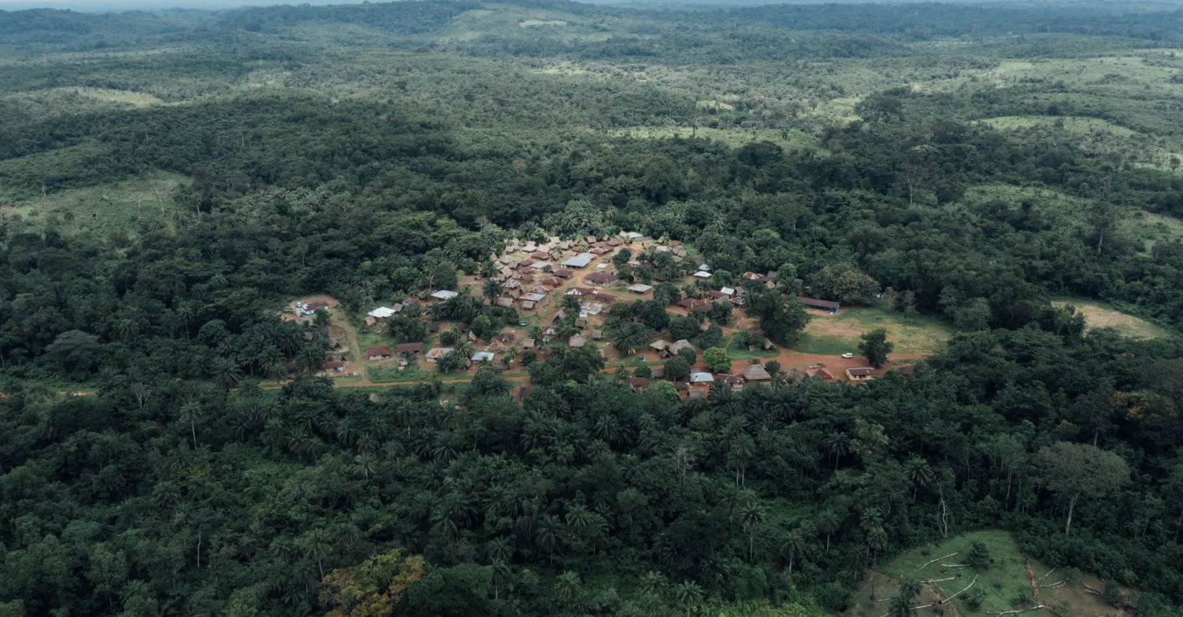


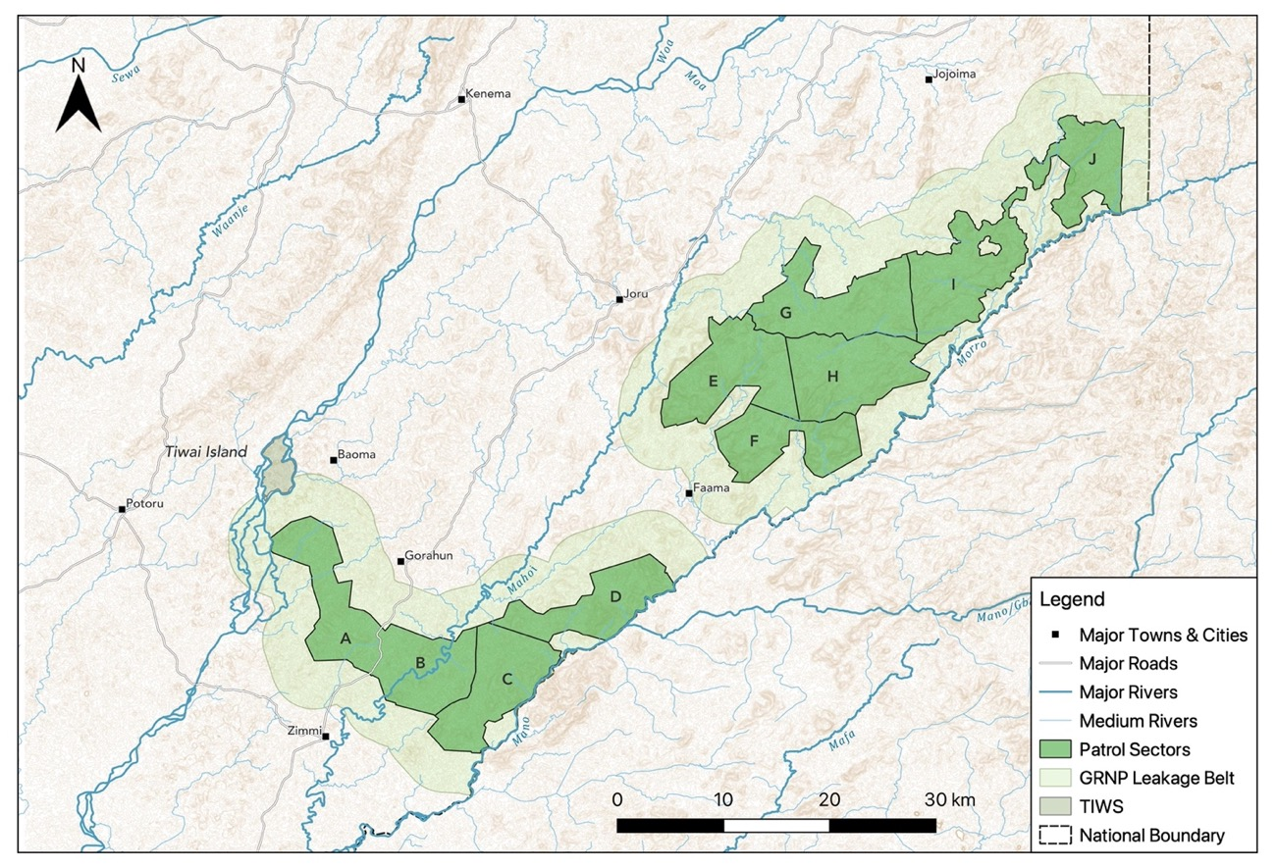
The Greater Gola Landscape - Future for Forests, People, and Biodiversity
Notes:
The Gola Rainforest National Park is Segmented into 10 Patrol Sector for efficient and accurate patrolling

Slide 13


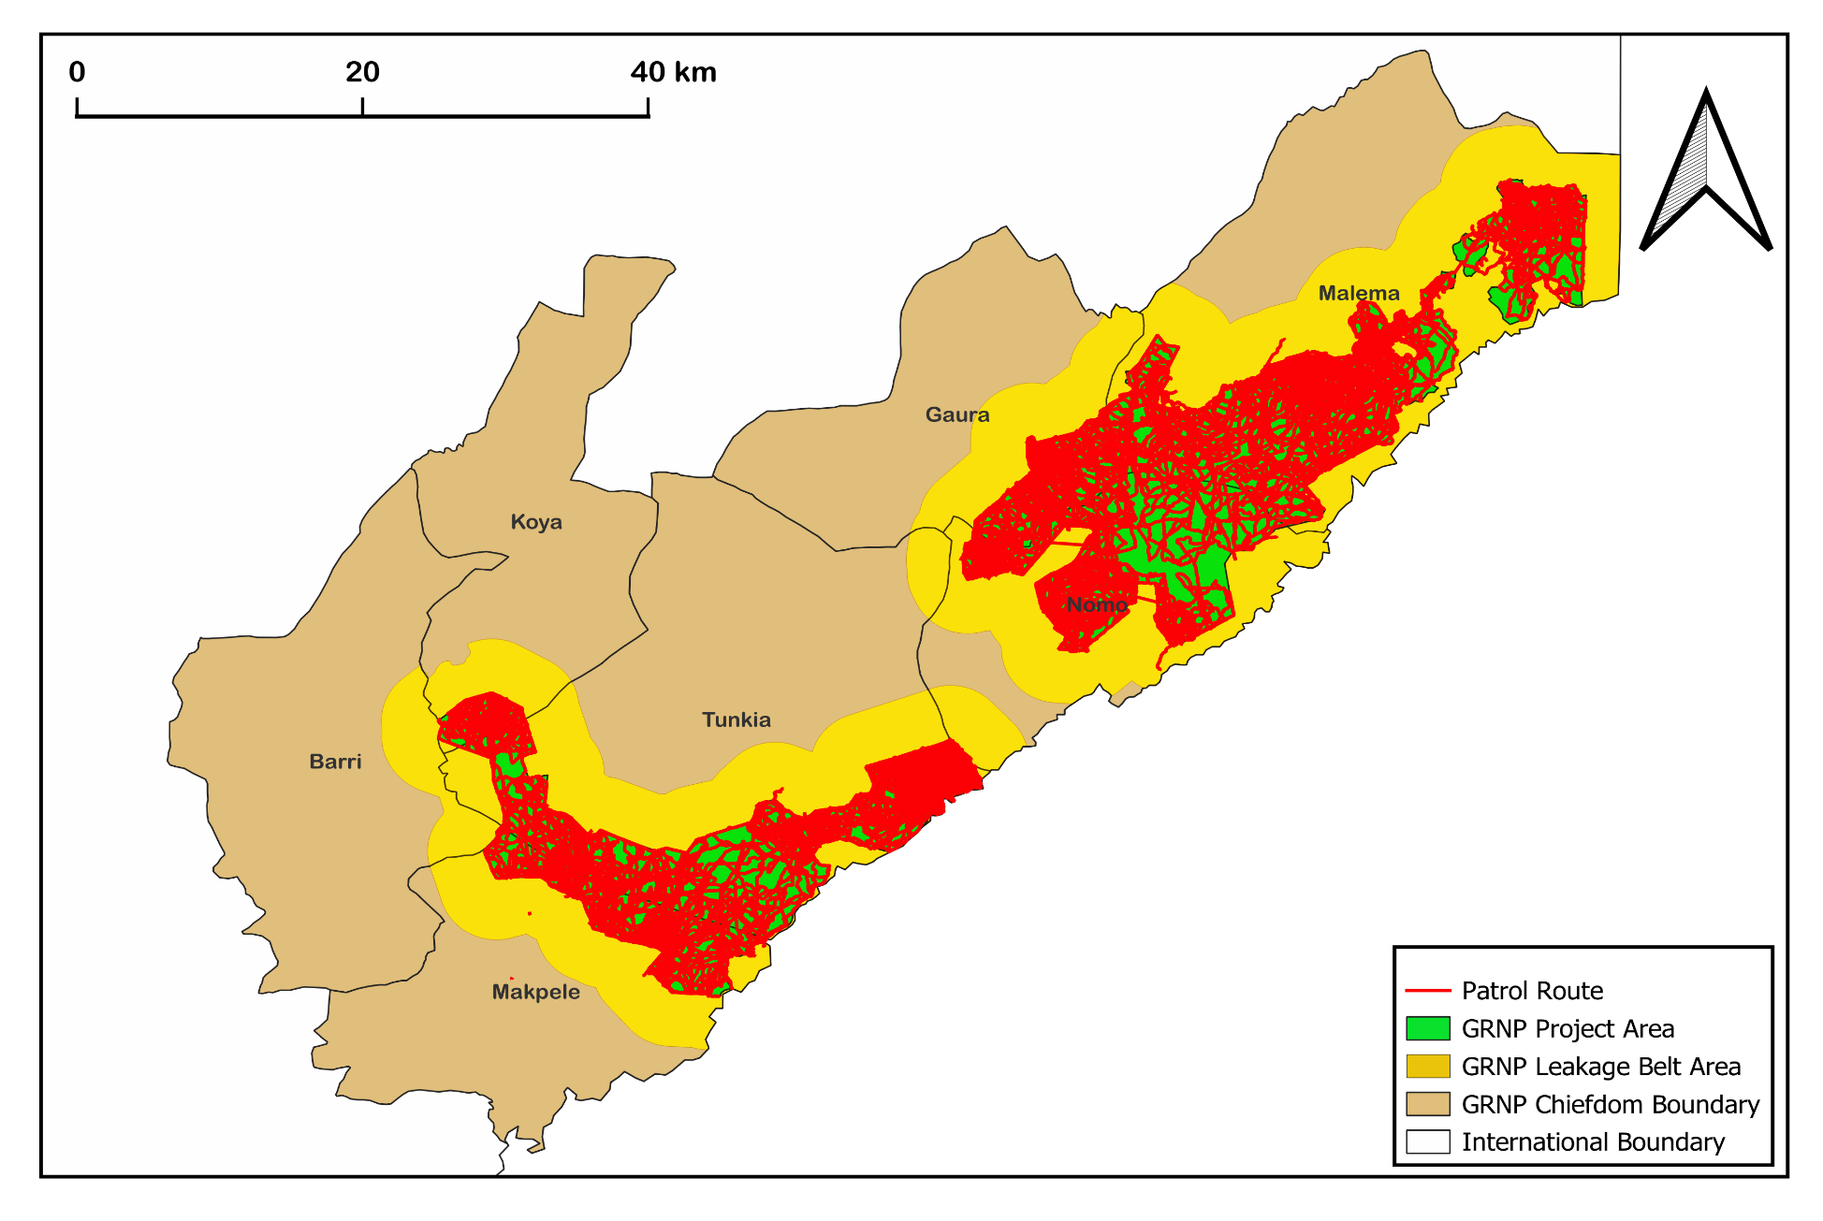
Patrol Coverage of GRNP Jan 2024 – March2025
Notes:
Summary of patrols conducted in 2024 - 2025. Rangers achieved 98% coverage of the park.
Rangers are split into units of 8, deployed for 2 weeks at a time with 1 week off between patrol missions. Clustering of patrols in areas of concern e.g. Baoma Nomo near active mine in Liberia

Slide 14
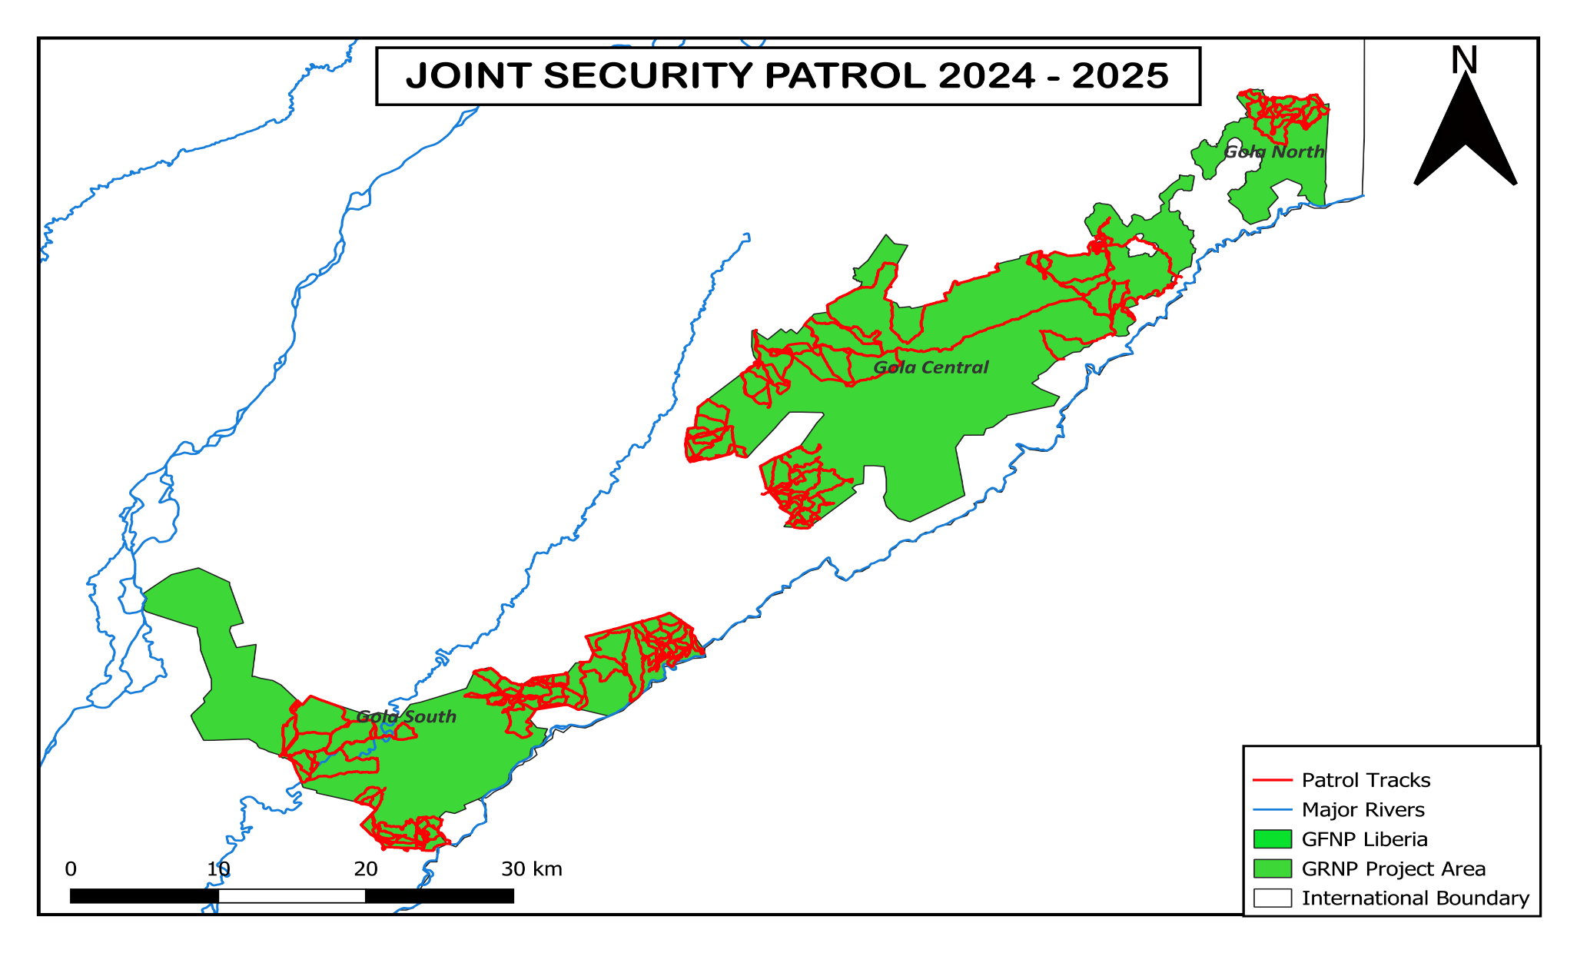
Joint Security Patrol Jan 2024 – March2025
Notes:
GRNP prepare patrol plans for Joint Security with the Sierra Leone Arm Forces (SLA) and the Sierra Leone Police (SLP)

Slide 15
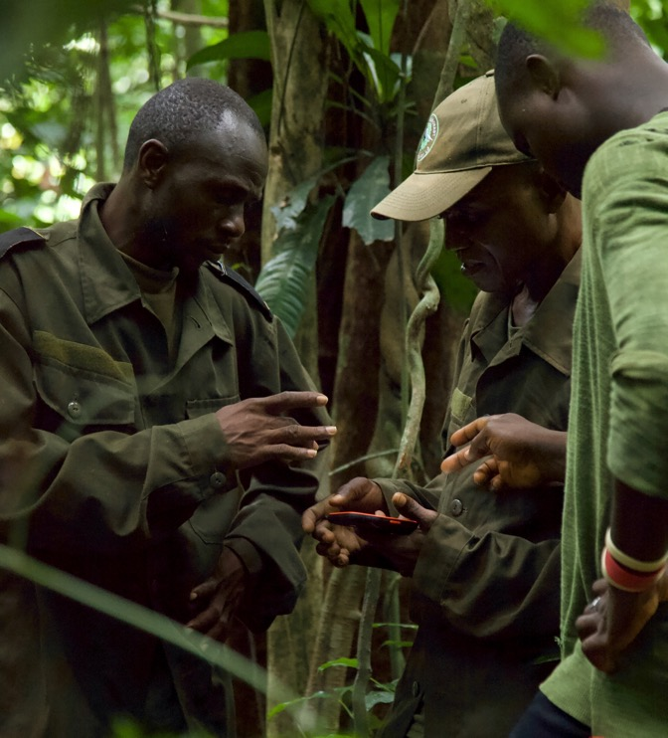


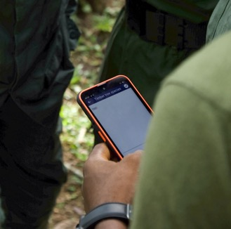

GOLA RAINFOREST CONSERVATION
SMART Patrols
Spatial Monitoring and Reporting Tool
Jan 2024 – Mar 2025
54 Rangers
167 Patrols
16,191 km
99 Signs of Hunting
14 Signs of Habitat Disturbance
8 Threatened Mammal Sightings
4 Threatened Bird Sightings
22 Joint Security Patrols
1,278 km
Notes:
Key stats from 2024-2025 SMART patrols. SMART Mobile rolled out in 2023 to all rangers. This is our first year of conducting patrols fully thorough SMART. Data are all uploaded to a central database. Tracks and observations analyzed to support future patrol planning. All protected areas in the landscape are now running off the same patrol monitoring system.

Slide 16
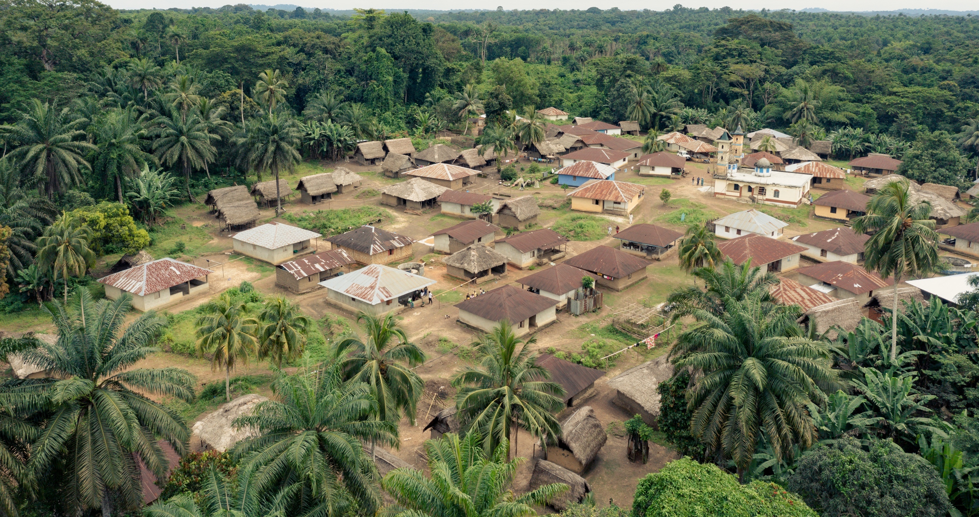
Community Development
The project has funded multiple community initiatives that help to build sustainable economic opportunities to ensure the change is permanent and rebuild infrastructure and services like schools, community halls, and clinics.
24,000+ people in 122 forest-edge communities directly benefit from the project
Wider population of 7 Gola Chiefdoms (240,000+) benefit from project interventions

Slide 17
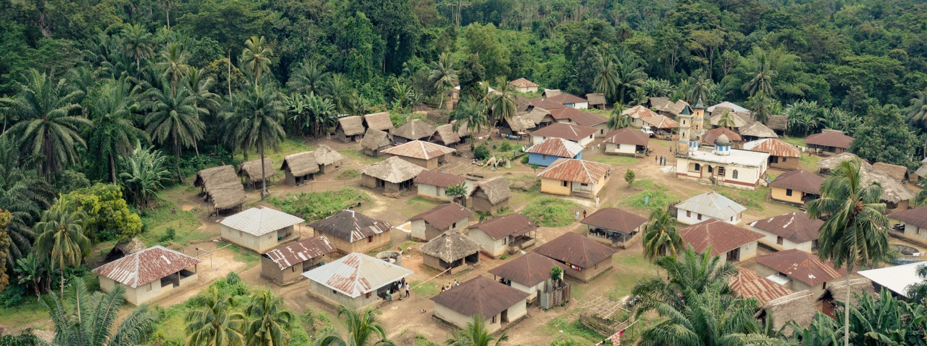



Livelihood Support
Education & Outreach
Capital Development
Community Development
Agricultural Intensification
Crop-Raiding
Land-Use Planning
School Support
Nature Clubs
Environmental Roadshows
Village Savings and Loans (VSLA)
Community Development Fund
Notes:
Community development department is structured into distinct units: agriculture, environmental education, VSLA, land-use planning and co-management, CDF

Slide 18
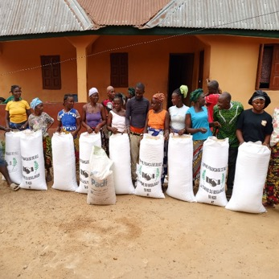
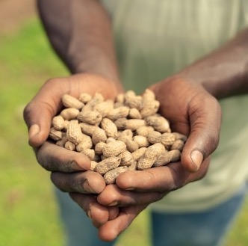
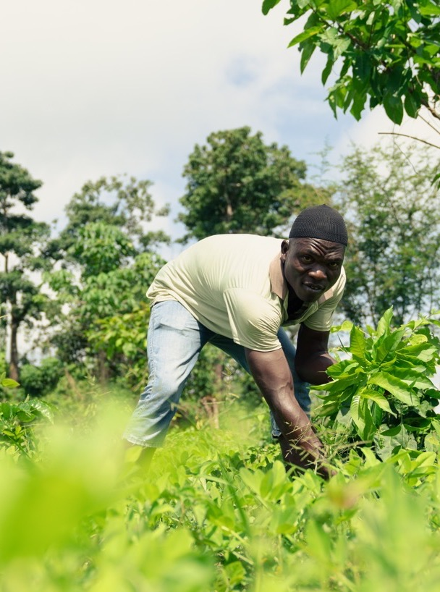



GOLA RAINFOREST CONSERVATION
Crop Intensification
Farmer Training
701 Farmers trained in sustainable farming practices
54 training sessions across 18 FECs
Sustainable Intensification
1,620kg of groundnut produced by farmers supported through the programme
750kg IVS Rice harvested
Crop Raiding
Addressing community concerns and perceptions in Malema.
Notes:
GRC-LG established 22 Farmer Field Schools (FFS) across 21 communities in the seven Gola chiefdoms, focusing on groundnut, vegetable, cassava, and inland valley swamp (IVS) rice farming.
GRC-LG also supported 30 pro-poor farmers (15 men, 15 women) from ten communities with 30 bushels (750 kg) of IVS rice, 60 cutlasses, and NLe 200 in cash for food-for-work initiatives.
Achieved a significant yield increase, harvesting 1,620 kg of groundnuts across the five communities, compared to the 864 kg initially supplied.

Slide 19
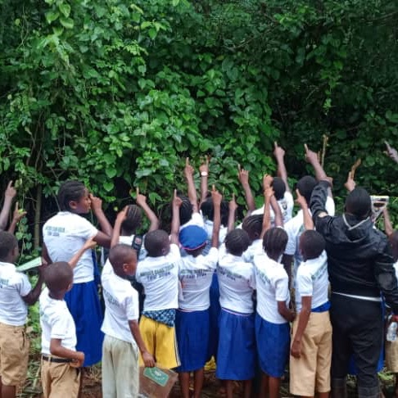

GOLA RAINFOREST CONSERVATION
Environmental Education
2,500+
Roadshow Participants on World Heritage Sensitization Roadshows and focus on REDD+ benefits and forest protection
370
Species-Specific Roadshow Participants
Notes:
The project has three components (i) environmental road shows consisting of visual & audio presentations and performances organized by GRNP staff in villages throughout the project zone (principally within FECs); (ii) establishment of nature clubs in primary and secondary schools throughout the project zone (principally in schools serving FECs) and provision of teaching materials and support with running field visits to the National Park; (iii) awarding of annual secondary school scholarships covering school fees, uniforms, and a school bag for 1 male and 1 female child from each FEC.
(iv) The new university scholarship scheme was awarded university students across the seven Gola chiefdoms

Slide 20

Community Forestry & Land-use Planning
Key Achievements
By-laws successfully established in three communities (Jenne, Takpoima, and Jagolahun) in Malema Chiefdom.
An exchange visit for Resource Users Group members and community members to the FAO Community Forestry site in Boama Dasse, Moyamba District.
Community By-Laws Overview:
1. Jenneh
Farming: Land allocation requires town chief approval.
Plantation: Permanent crops on others' land are prohibited.
Stealing: Fines of Le1,500 and further action at the chiefdom level.
Logging: Prohibited near the National Park boundary; fines up to Le700,000 and board confiscation for community use.
2. Takpoima & Jagolahun
Farming: All farms must be cleared together and 5m buffer zones must be maintained near roads.
Fire Prevention: Reckless fire handling leads to fines or damage repayment.
Respect for Chiefs/Elders: Indecent language against elders incurs a fine.
Notes:
Community Forestry work started in earnest in 2018
14 community forests established in 2022 with support from the Darwin Initiative project in Malema Chiefdom.
following are their activities;
Establish community conserved forest
Develop community land use plan
Form natural resources users groups
Form community forestry management committees
Lessons from this process to be integrated into the REDD programme and rolled out across other 6 chiefdoms and broader Malema area.

Slide 21
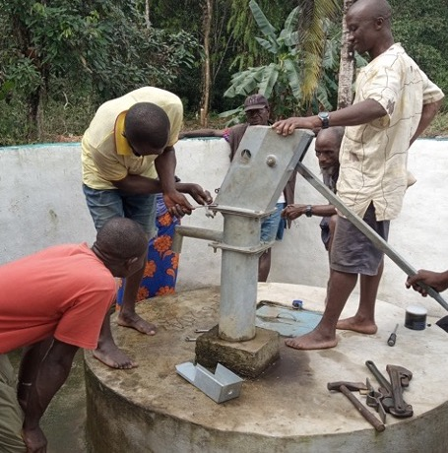
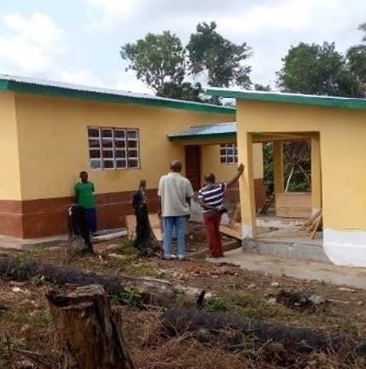
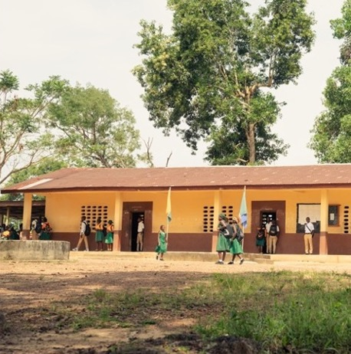
GOLA RAINFOREST CONSERVATION
Water Well
Community Health Centre
School Rehabilitation
Community Development Fund
Notes:
The project provides each of the 7 Chiefdoms with an annual community development fund which is to be used by communities for implementing sustainable development projects.
Potential project ideas for using the community development funds are developed by the offsite communities, selected and evaluated by the GCDC members and implemented by offsite communities once projects are approved by the Gola management team.
Such projects can include reforestation, rehabilitation of plantations, agriculture enhancement projects or other projects that aim to enhance livelihoods in a sustainable manner thus mitigating further impacts on biodiversity.
Often these also include infrastructural improvements such as the construction of water wells, school buildings and health centres.
Project implementation is monitored by GRNP staff and an evaluation is completed 1-6 months after the completion of each project.

Slide 22
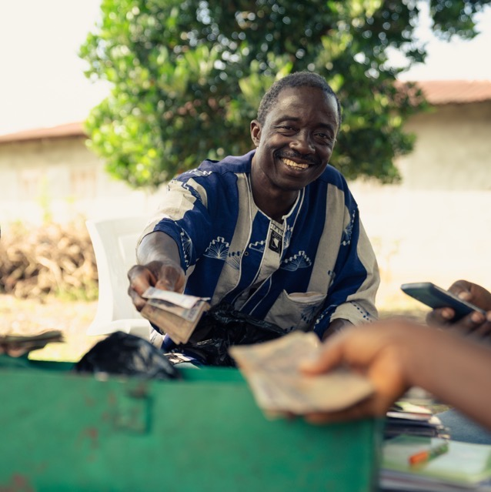
GOLA RAINFOREST CONSERVATION
Village Savings and Loans (VLSA)
1,950
47
Members trained in Business Management and Share-out
VSLA Groups Monitored
45
564
Training Workshop Conducted
VSLA Meetings Held
NLE 346,318
Total savings from seven groups in Nomo Chiefdom
Notes:
The Village Savings and Loans Association (VSLA) programme is a microfinance initiative that is intended to provide basic, community-managed savings and loan facilities in communities that do not have easy access to financial services and at the same time increase financial literacy to the target communities. For each of the FECs communities targeted capacity support is implemented over a period of 2 years to improve financial literacy.
VSLA groups of 20-25 members during which a governing committee of 5 members are elected and by-laws are established. The groups are then provided with materials including a metal safe deposit box, savings and loan books. Group meetings occur regularly throughout the cycle (usually weekly or bi-weekly), and at each meeting all members deposit a saving and a small contribution into a social fund (minimum and maximum saving and contribution amounts are set in the bylaws).
Table shows average quarterly savings for 24 active VSLA groups across 14 communities in Nomo

Slide 23





GOLA RAINFOREST CONSERVATION
Supporting Communities
Continuous Monitoring of Students Supported
9 CDF Projects
Completed
3 Communities Adopting New Forest By-Laws
47 VSLA Groups Supported
689 Farmers Trained

Slide 24
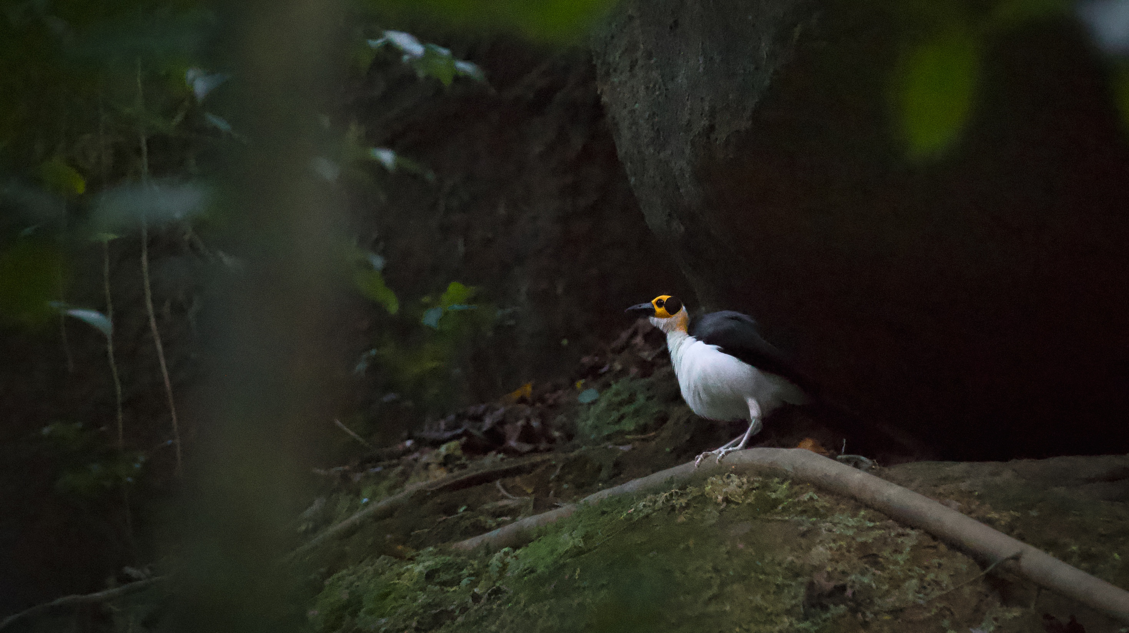





Biodiversity
The project protects the largest remnants of Upper Guinean Rainforest left in Sierra Leone.
Recognised as a Key Biodiversity Area, which includes:
330+ species of birds (11 threatened)
155 species of mammals (19 threatened)
12 species of primates (6 threatened)
1000+ species of plants
(33+ threatened)
54 species of amphibians (1 threatened)

Slide 25
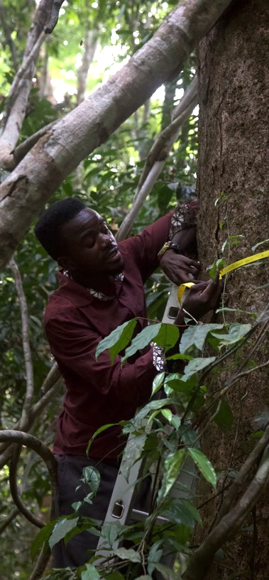
GOLA RAINFOREST CONSERVATION
Carbon Stock Enhancement
48 representative plots measured in Gola South for measuring changes in tree growth.
6 plots re-measured as ”blind check” verification.
919 live trees measured spanning 134 known species
Results:
Carbon stored per ha of forest increased from 670.5 in 2018 to 756.51 tonnes CO₂/ha in 2024
Over 1.7 million tonnes of CO₂ sequestered as a result of project activities from 2019-2023
Notes:
Measured trees are identified by a botanist, tagged with individual numbers and painted at DBH (diameter at breast height, ca. 1.30m from ground)
Within big plot DBH of all trees above 30cm DBH are measured using DBH measuring tape
Within small plot all trees above 10cm DBH measured

Slide 26
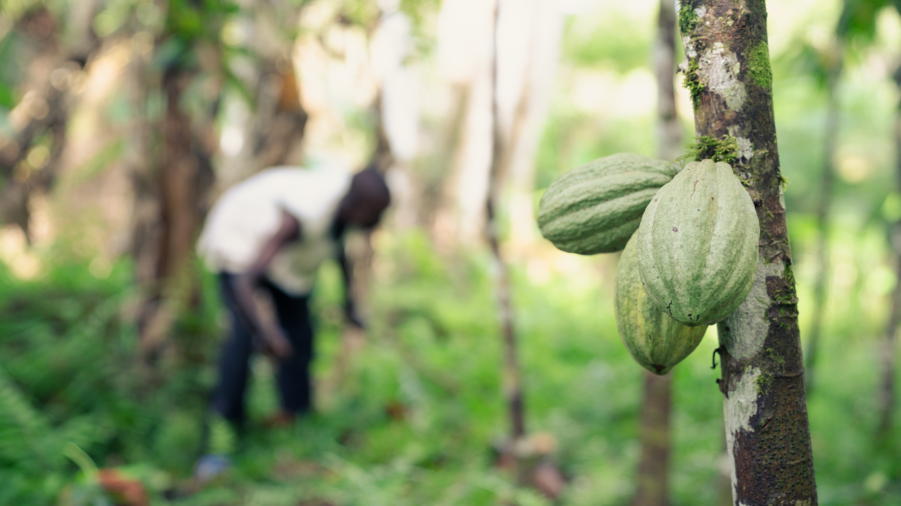
Enterprise
The project promotes sustainable cocoa agroforestry models to maximize livelihood benefits, maintain biodiversity and forest cover.
Developing local cocoa business through:
Organic certification
Cloud-based traceability
Improved market access and export facilitation
Formation and strengthening of farmers’ cooperatives

Slide 27
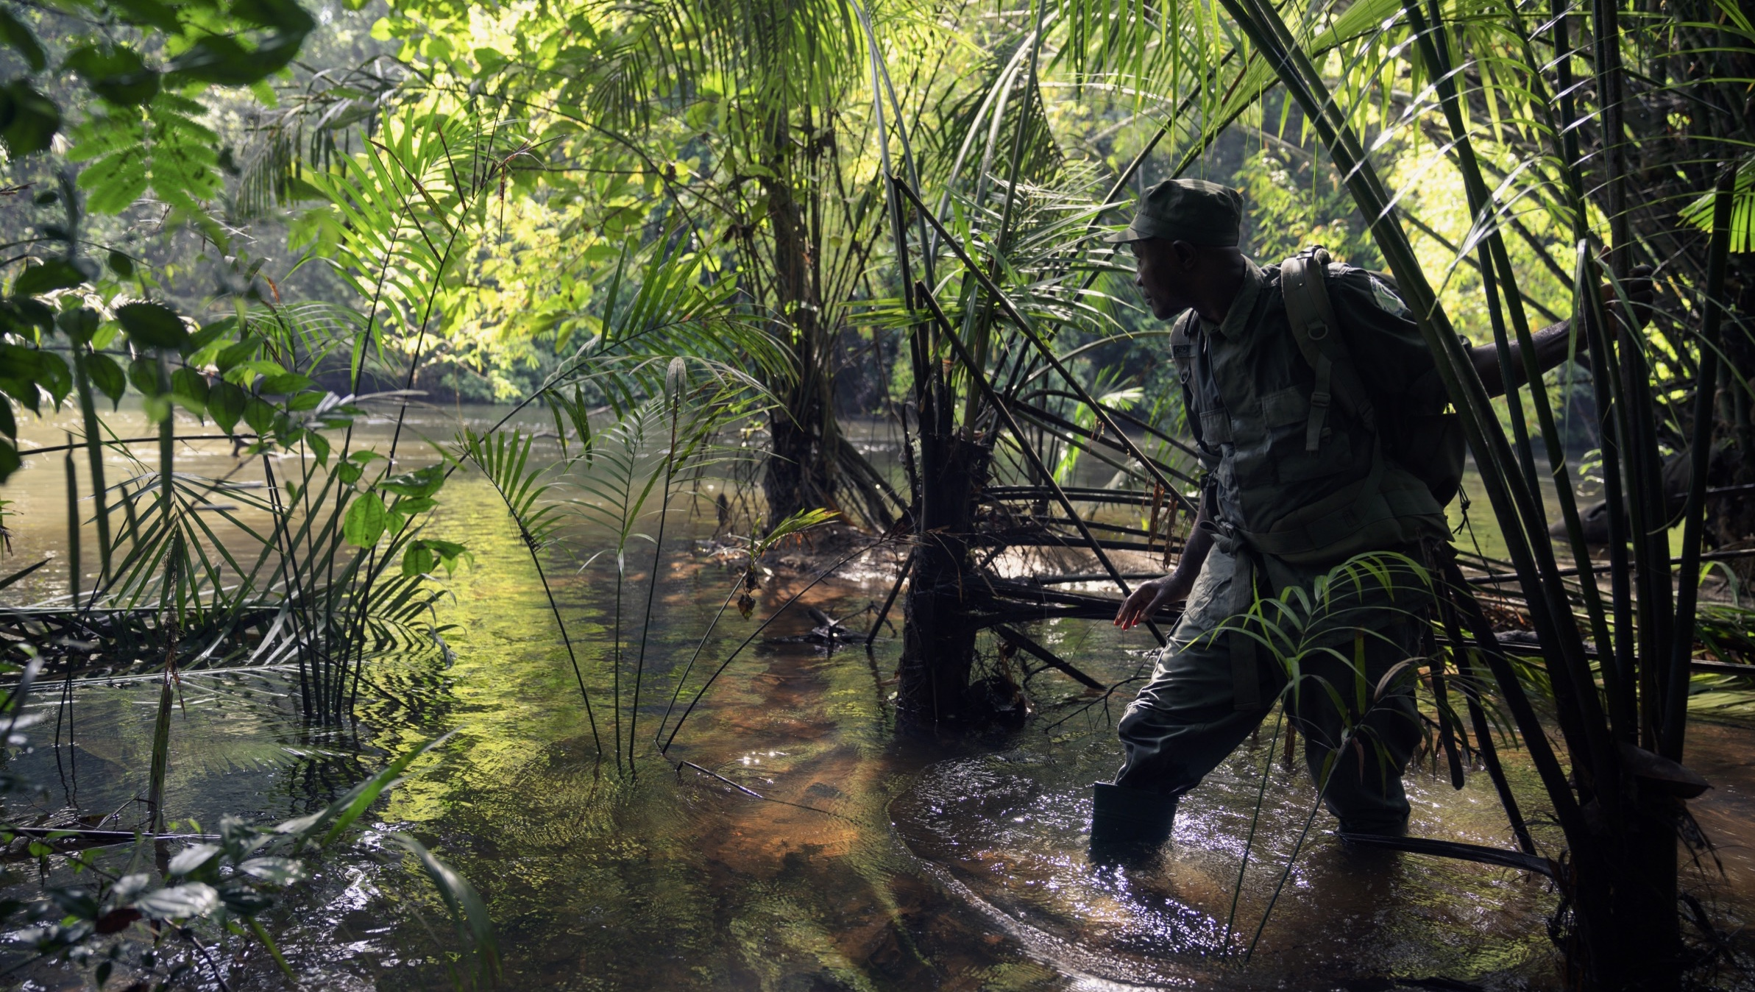
Looking Forward
All project stakeholders strongly believe that we are on the right track.
GRC is confident and becoming more efficient in the protection of GRNP.
REDD+ has kept Gola forests and biodiversity well protected.
Communities are reaping benefits of sustainable land use in nature conservation, agriculture, and livelihoods.
Gola is a positive win-win approach garnering respect and admiration in Sierra Leone and West Africa.
Gola-Tiwai Complex is being announced as a UNESCO World Heritage site.

Slide 28
Policy Recommendation
Strengthen forest governance and community rights.
Increase investment in conservation financing.
Enhance law enforcement and forest monitoring.
Integrate conservation into national development planning.
Support research and cross-border collaboration.

Slide 29
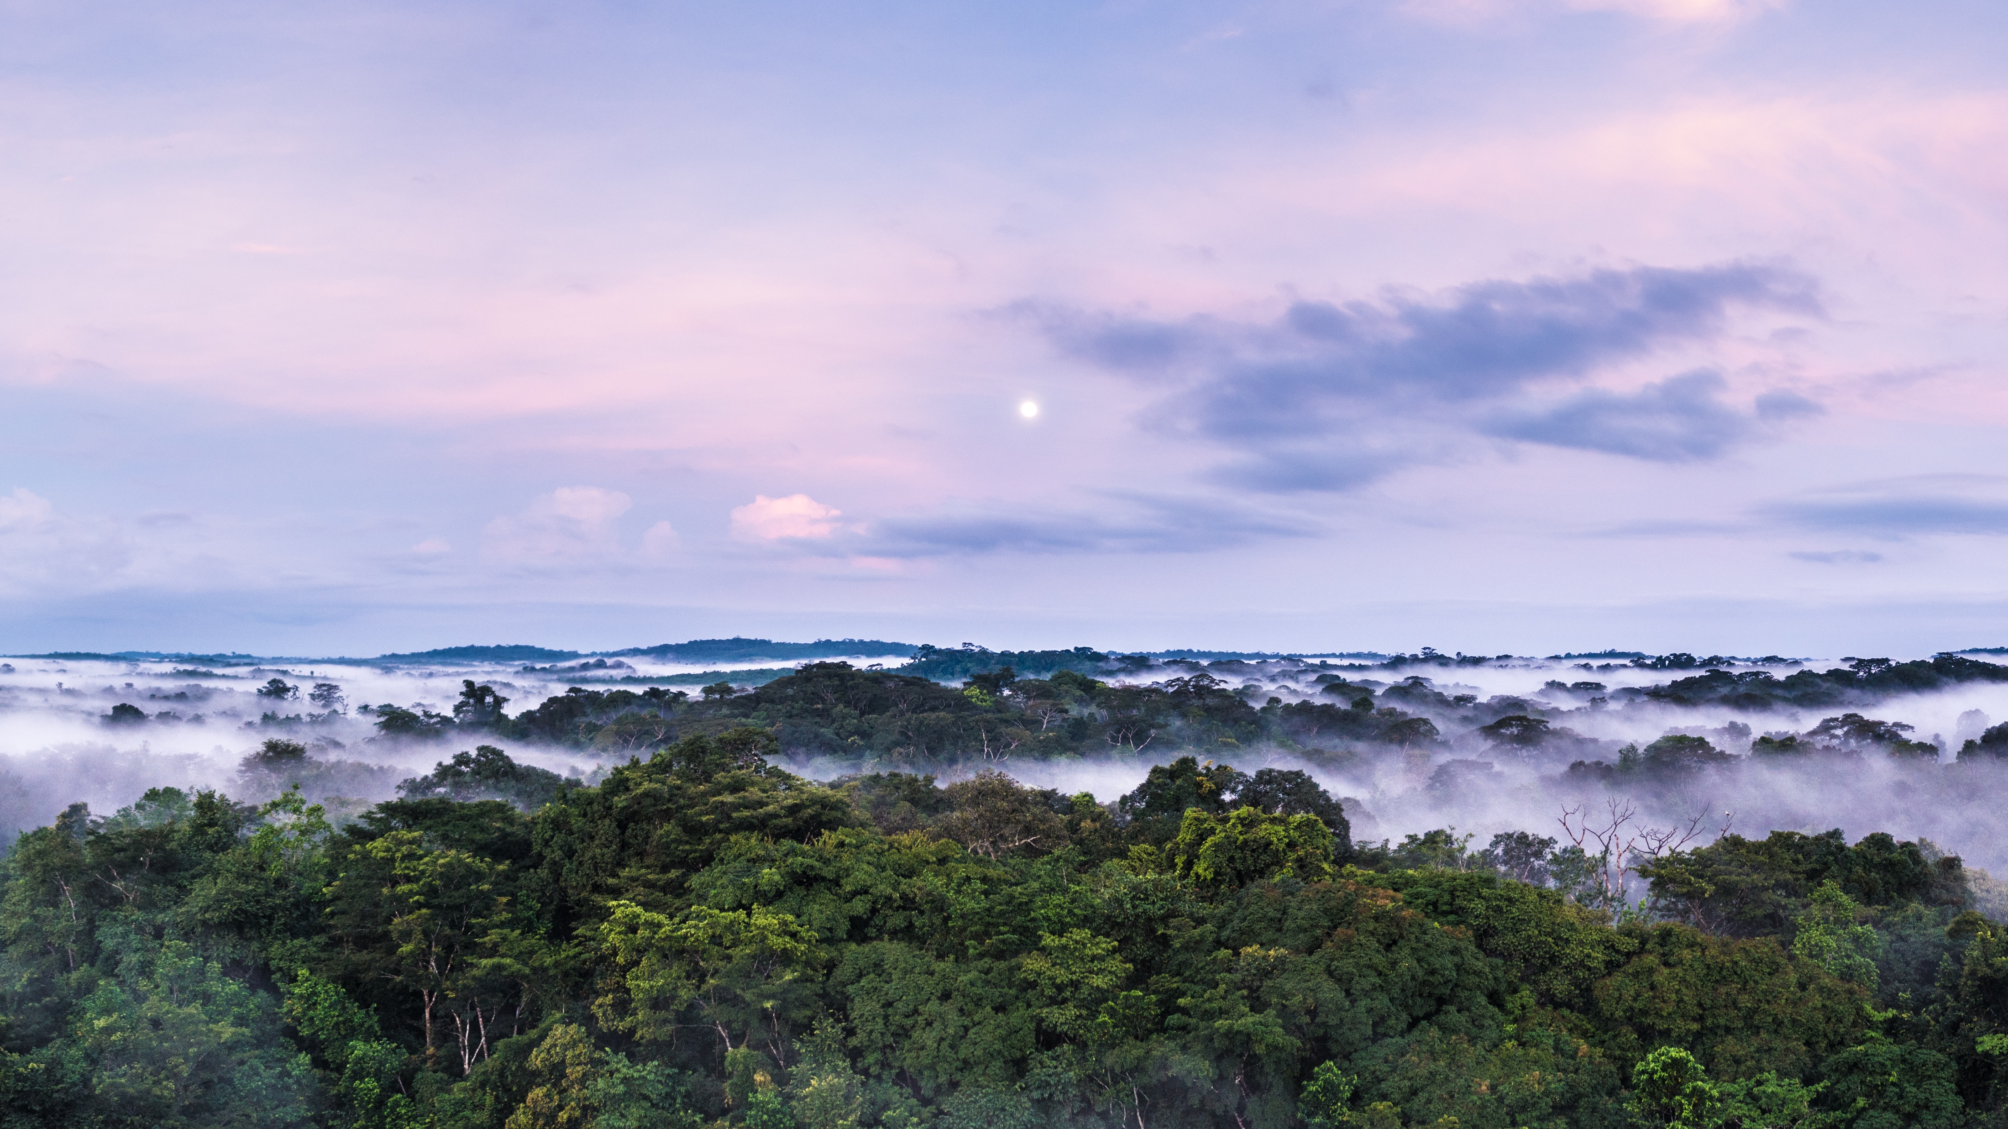
Contact
Website: www.golarainforest.org
Email: info@golarainforest.org
Social: @gola_rainforest_conservation
Address: 164 Dama Road, Kenema, Sierra Leone

Slide 30
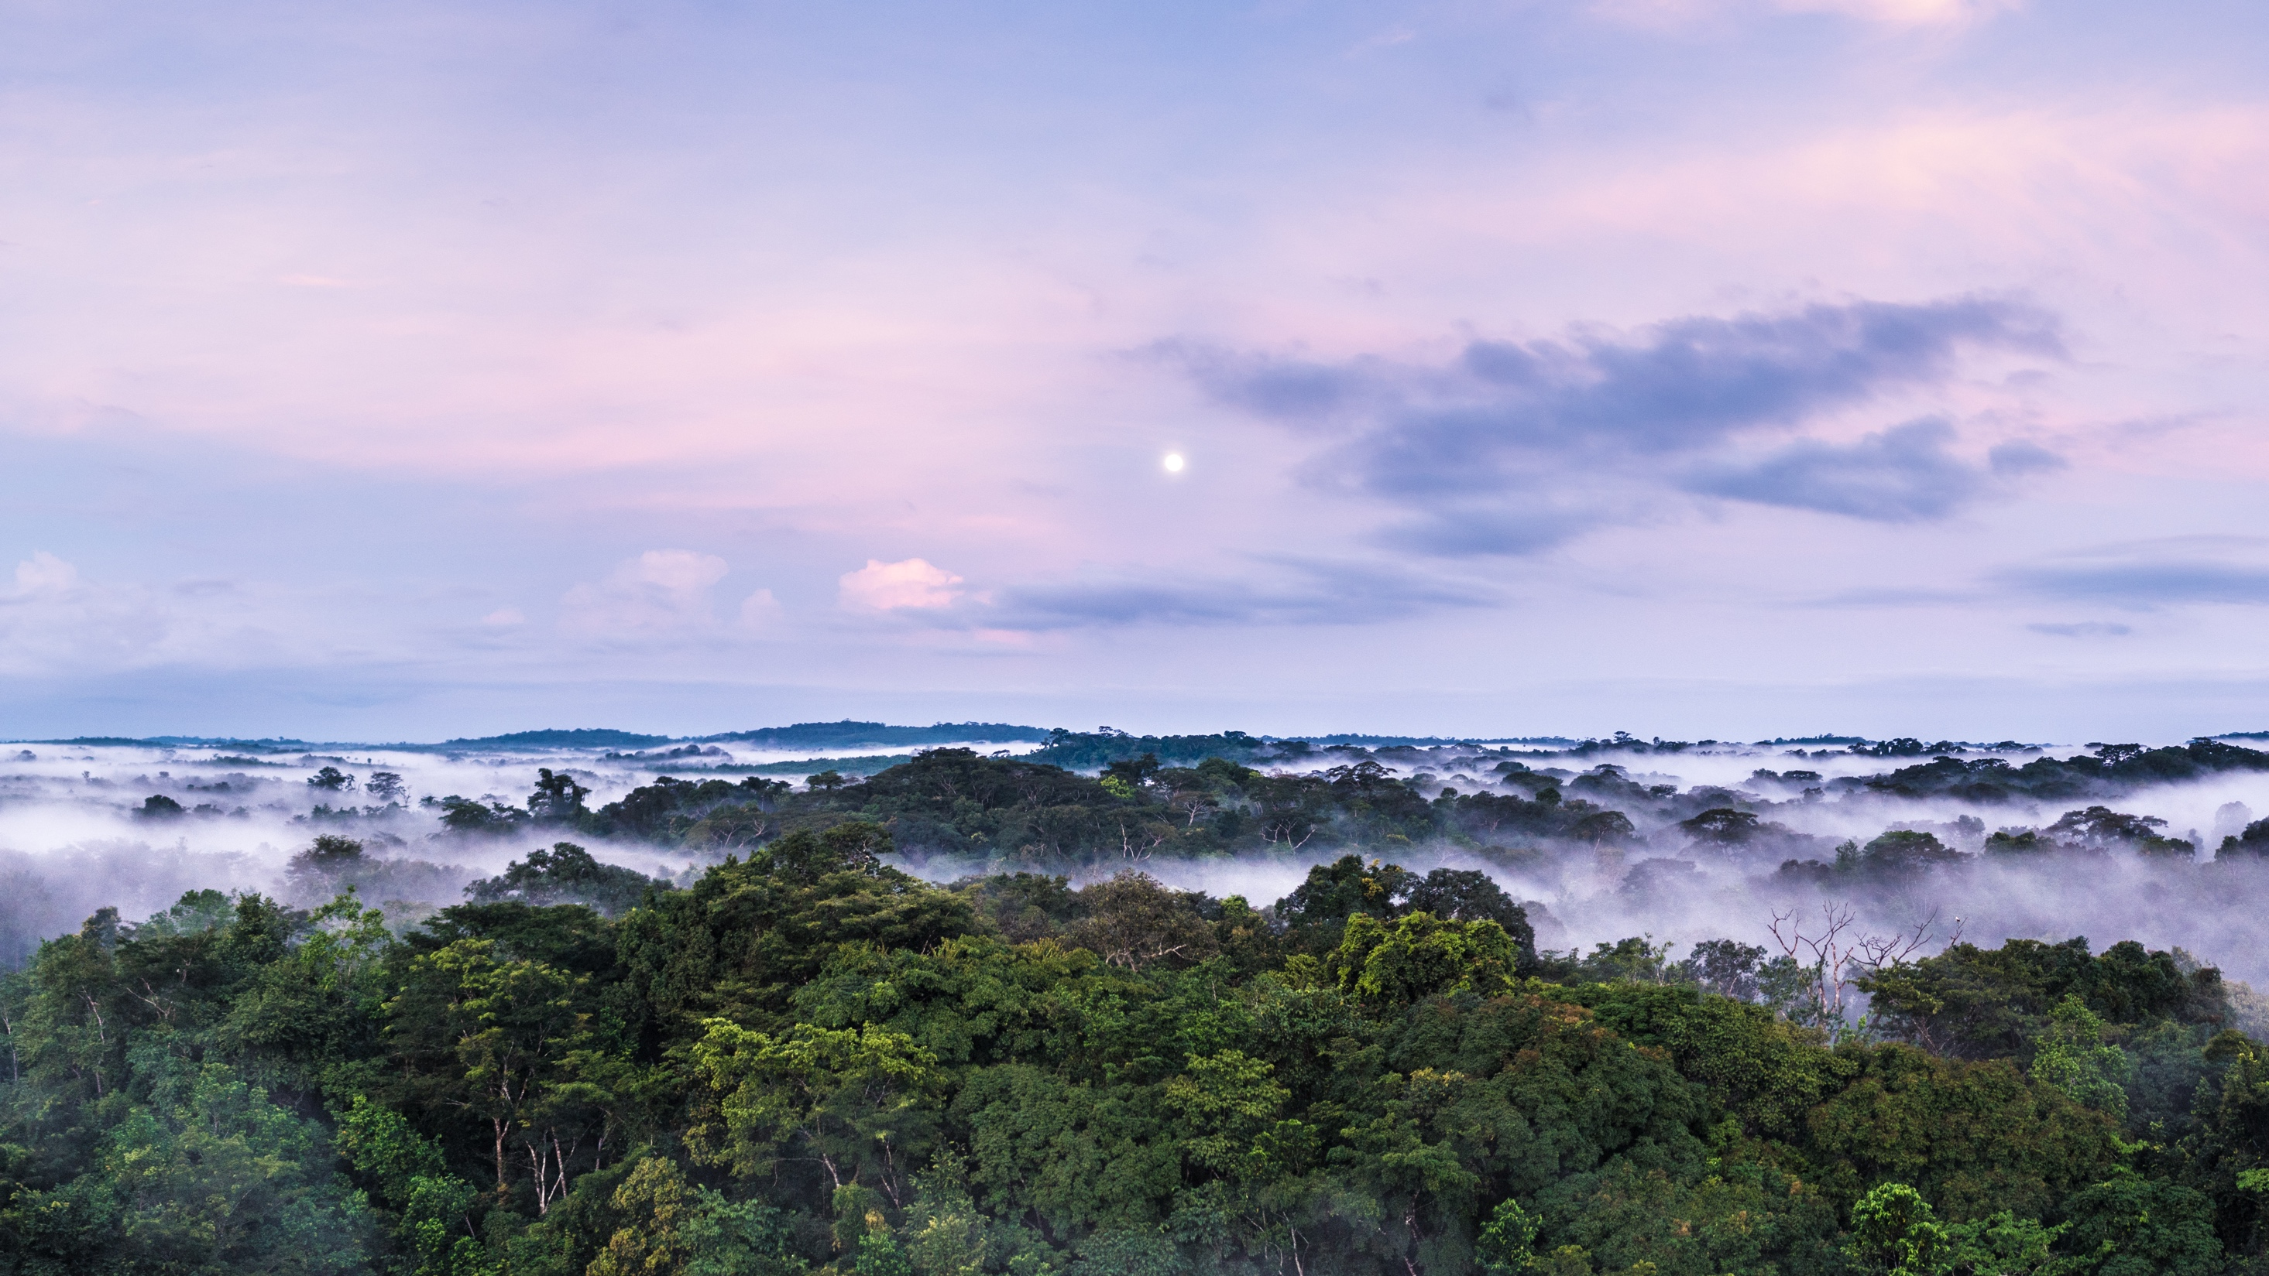
GOLA
A Forest of Hope

